Slide 1
Relating Run-Time and Compile-Time Structures

Slide 2
Run-Time and Compile-Time Structures
Compile time structure
Frozen at compile time
Classes are in fixed inheritance relationships
Run time structure
Changes rapidly
Relationships between objects are fluid

Slide 3

Aggregation vs Acquaintance
Aggregation:
An aggrege relationship is where one object contains another eg a car has a steering wheel
Acquaintance:
An acquaintance relationship is where one object knows of another eg a car can have a trailer

Slide 4
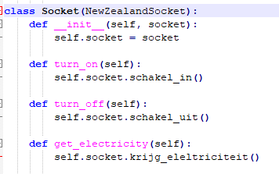
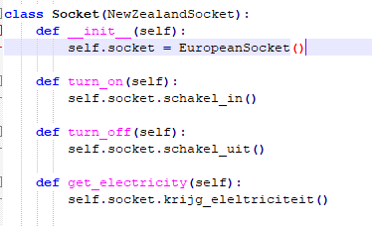


Code Example: Adapter GOF Test
Acquaintance (Associate)
Aggregate

